Slide 1


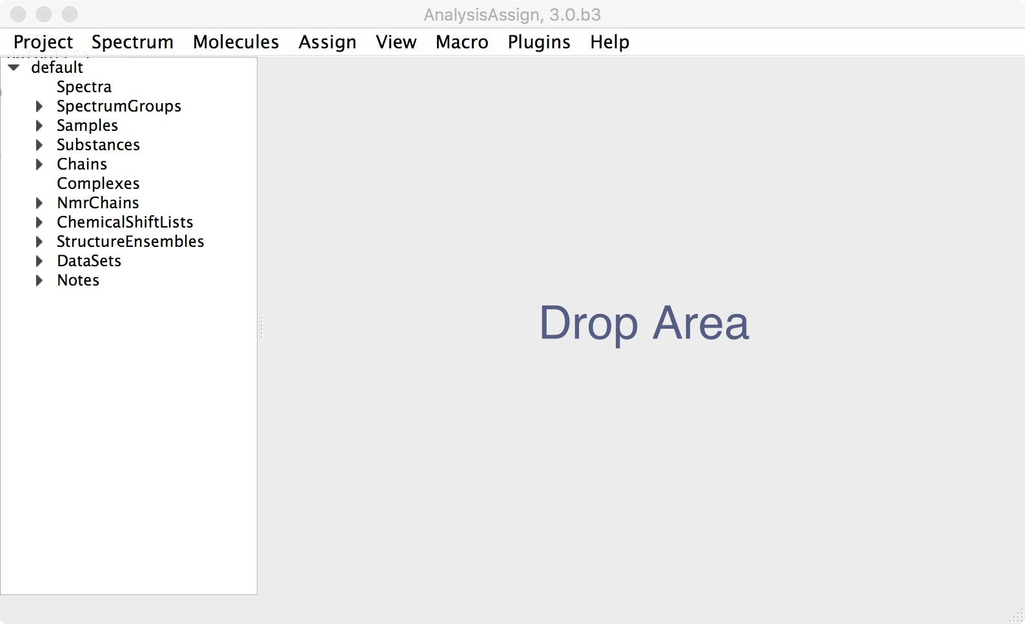
CcpNmr Analysis Version 3
Beginner Tutorial

Slide 2

Introduction
This tutorial will guide you through basic operations of CcpNmr Analysis Version 3. The tutorial is divided into sections, each of them will have a set of simple actions. Each page of this tutorial will correspond to a single operation, you will see a descriptive image on top and its full description below.
When you open the program you will see a large display area, with a sidebar to the left and a menu bar at the top. All the displays, tables, etc. go into the display area a new “module”. The sidebar shows the data in your project and lets you edit data items, create new ones, and drag the items into the display area to display them as a module. The menu bar lets you start actions and action modules. You can also start actions by two-key keyboard shortcuts, using the right mouse button, or from buttons and icons in the application.
Start CcpNmr Analysis V3
Apple users by double clicking the icon CcpNmrAnalysis
Linux users by using the terminal command: bin/assign

Slide 3
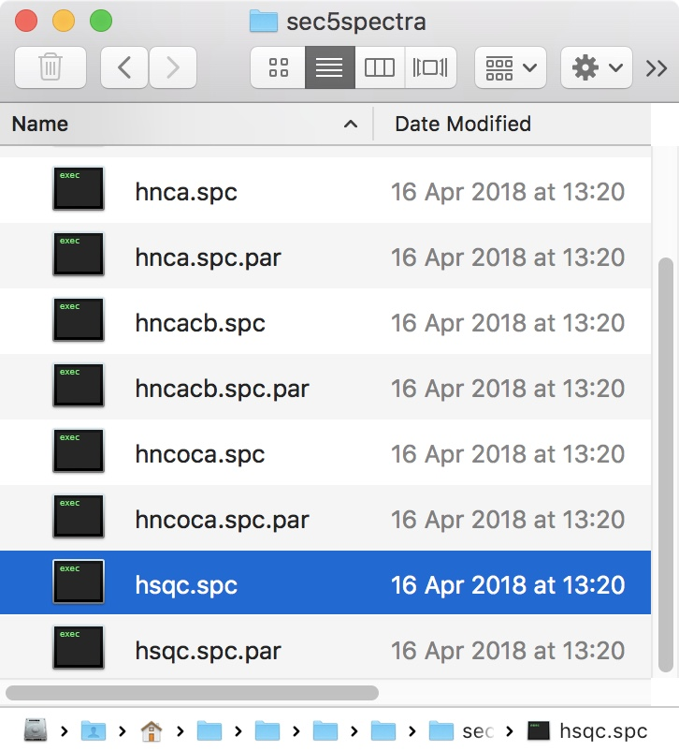
1
Loading spectra
Spectra location : AnalysisV3/data/CcpnSec5BBTutorial/sec5spectra
1A
Drag & drop the spectra into the sidebar or drop area.
Find the hsqc on the demo spectra directory (AnalysisV3/data/CcpnSec5BBTutorial/sec5spectra)
select it in finder and drag it onto the sidebar or drop area.
If you drop it on drop area, the spectrum will be displayed immediately, if you drop on sidebar you will need an extra step to display it (1B).
You will also see a arrow appear next to the Spectra label in the sidebar showing that the spectrum has been loaded.

Slide 4
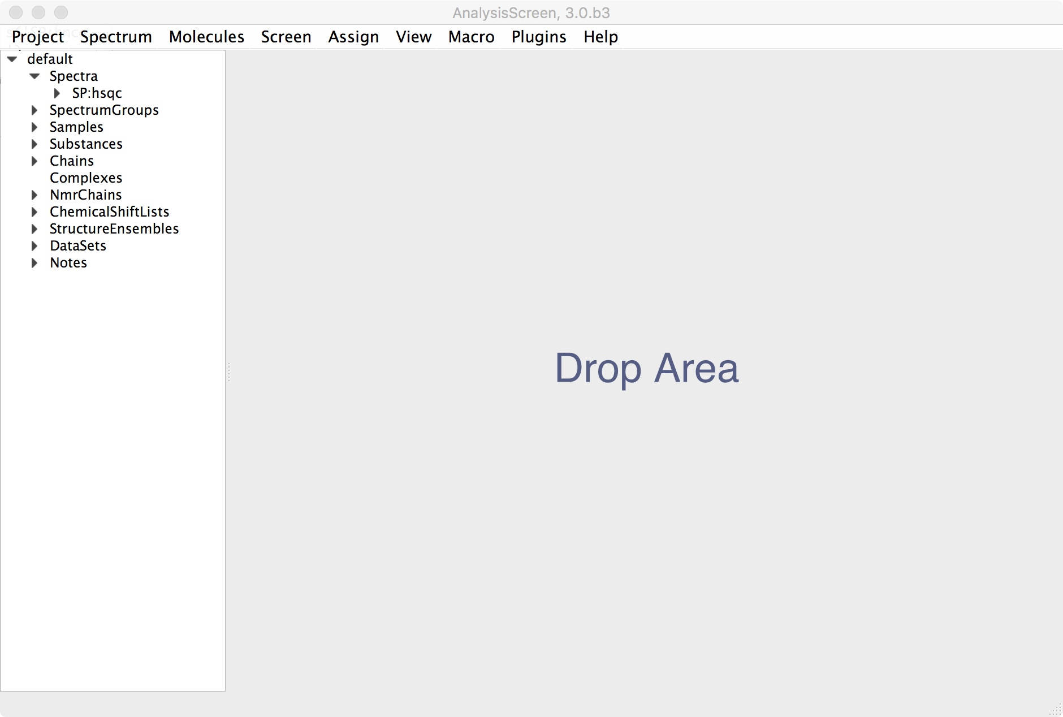
1
Loading spectra
Drag & drop from Sidebar
1B
Drag & drop the spectra From the sidebar to the drop area.
Select the spectrum you want to display on sidebar
Drag and drop it to the main drop area
Alternatively:
right click on the sidebar item:
click on open as module
Right Click on Sidebar Item

Slide 5
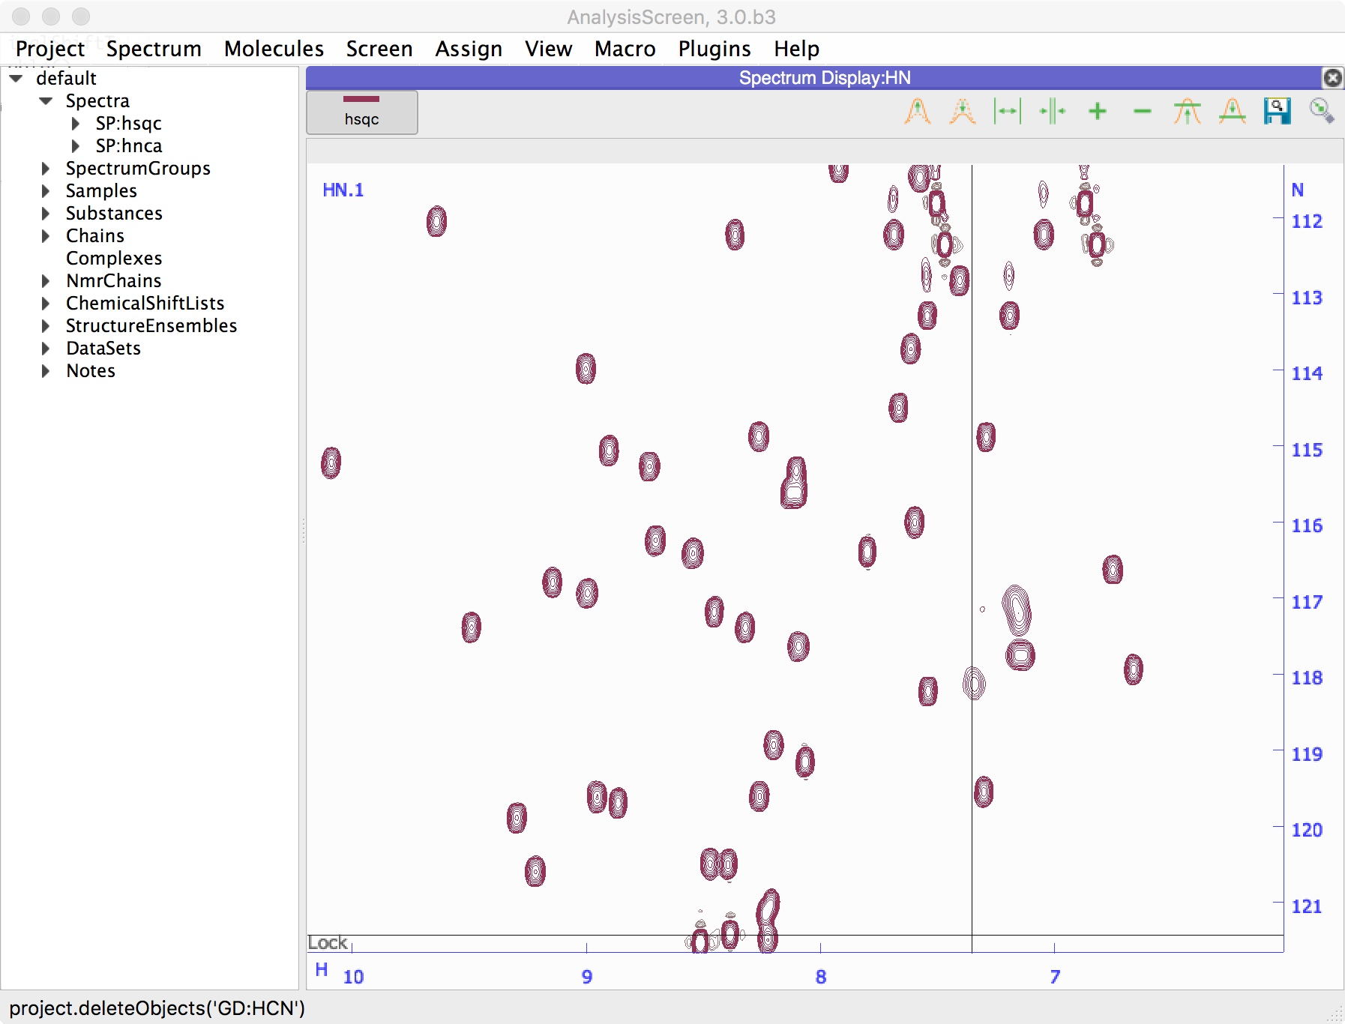
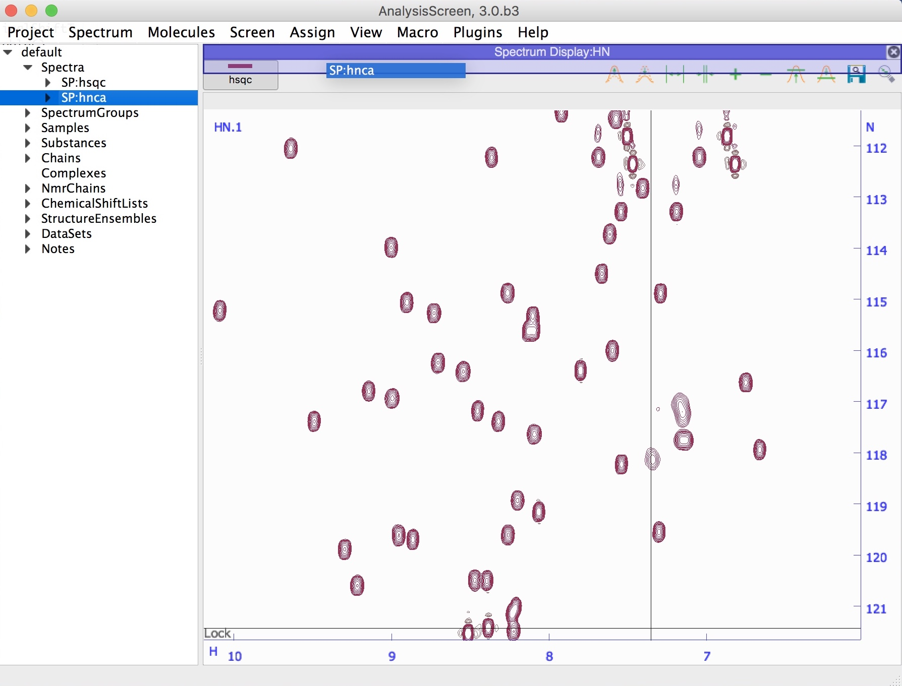
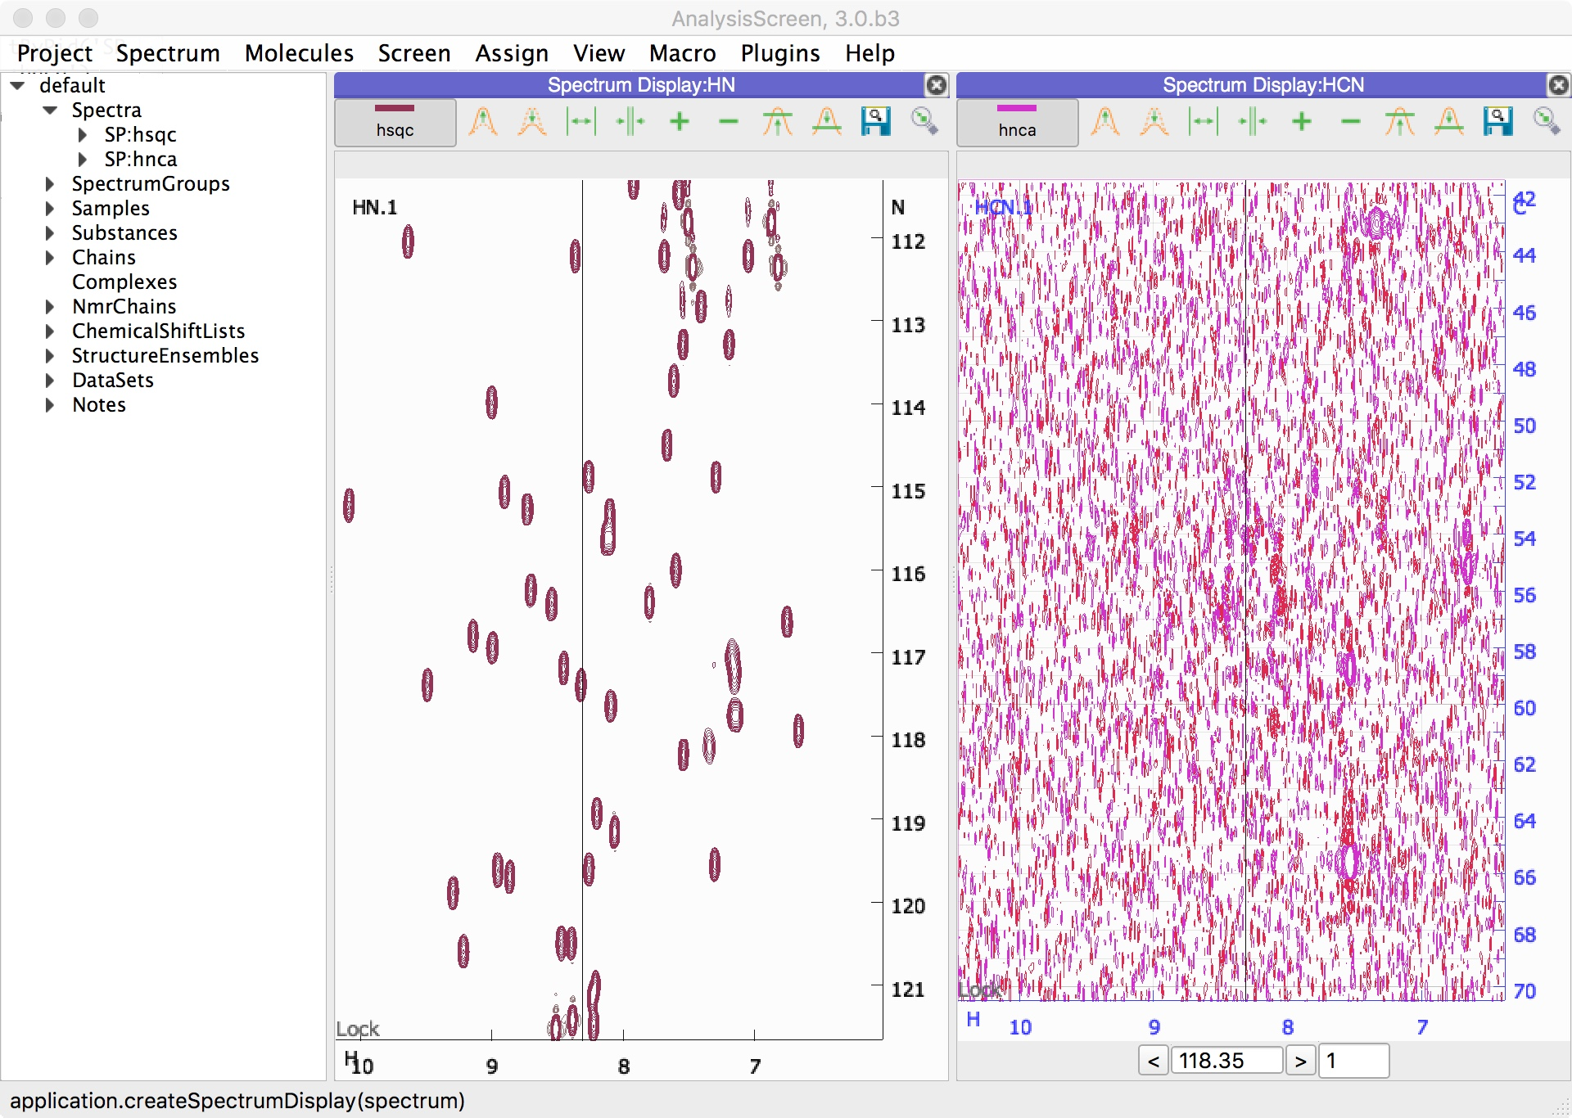
1
Loading spectra
Drag over the purple bar then drop
1C
Display more spectra.
Add a new spectrum to the project (like 1A), for example the hnca
Select it on sidebar, hold down the left mouse button and start to drag
Drag it to the top bar of the currently displayed spectrum without dropping yet. When a semi-transparent purple box appears, the drop area is ready to accept the drop and you can release the button. If you keep holding you can choose another location where to display the spectrum.
The purple box represents the target location where to open the new module. Keep holding the left click and move at the edges of the target module (left, right, top or bottom) then drop the item to display it.

Slide 6
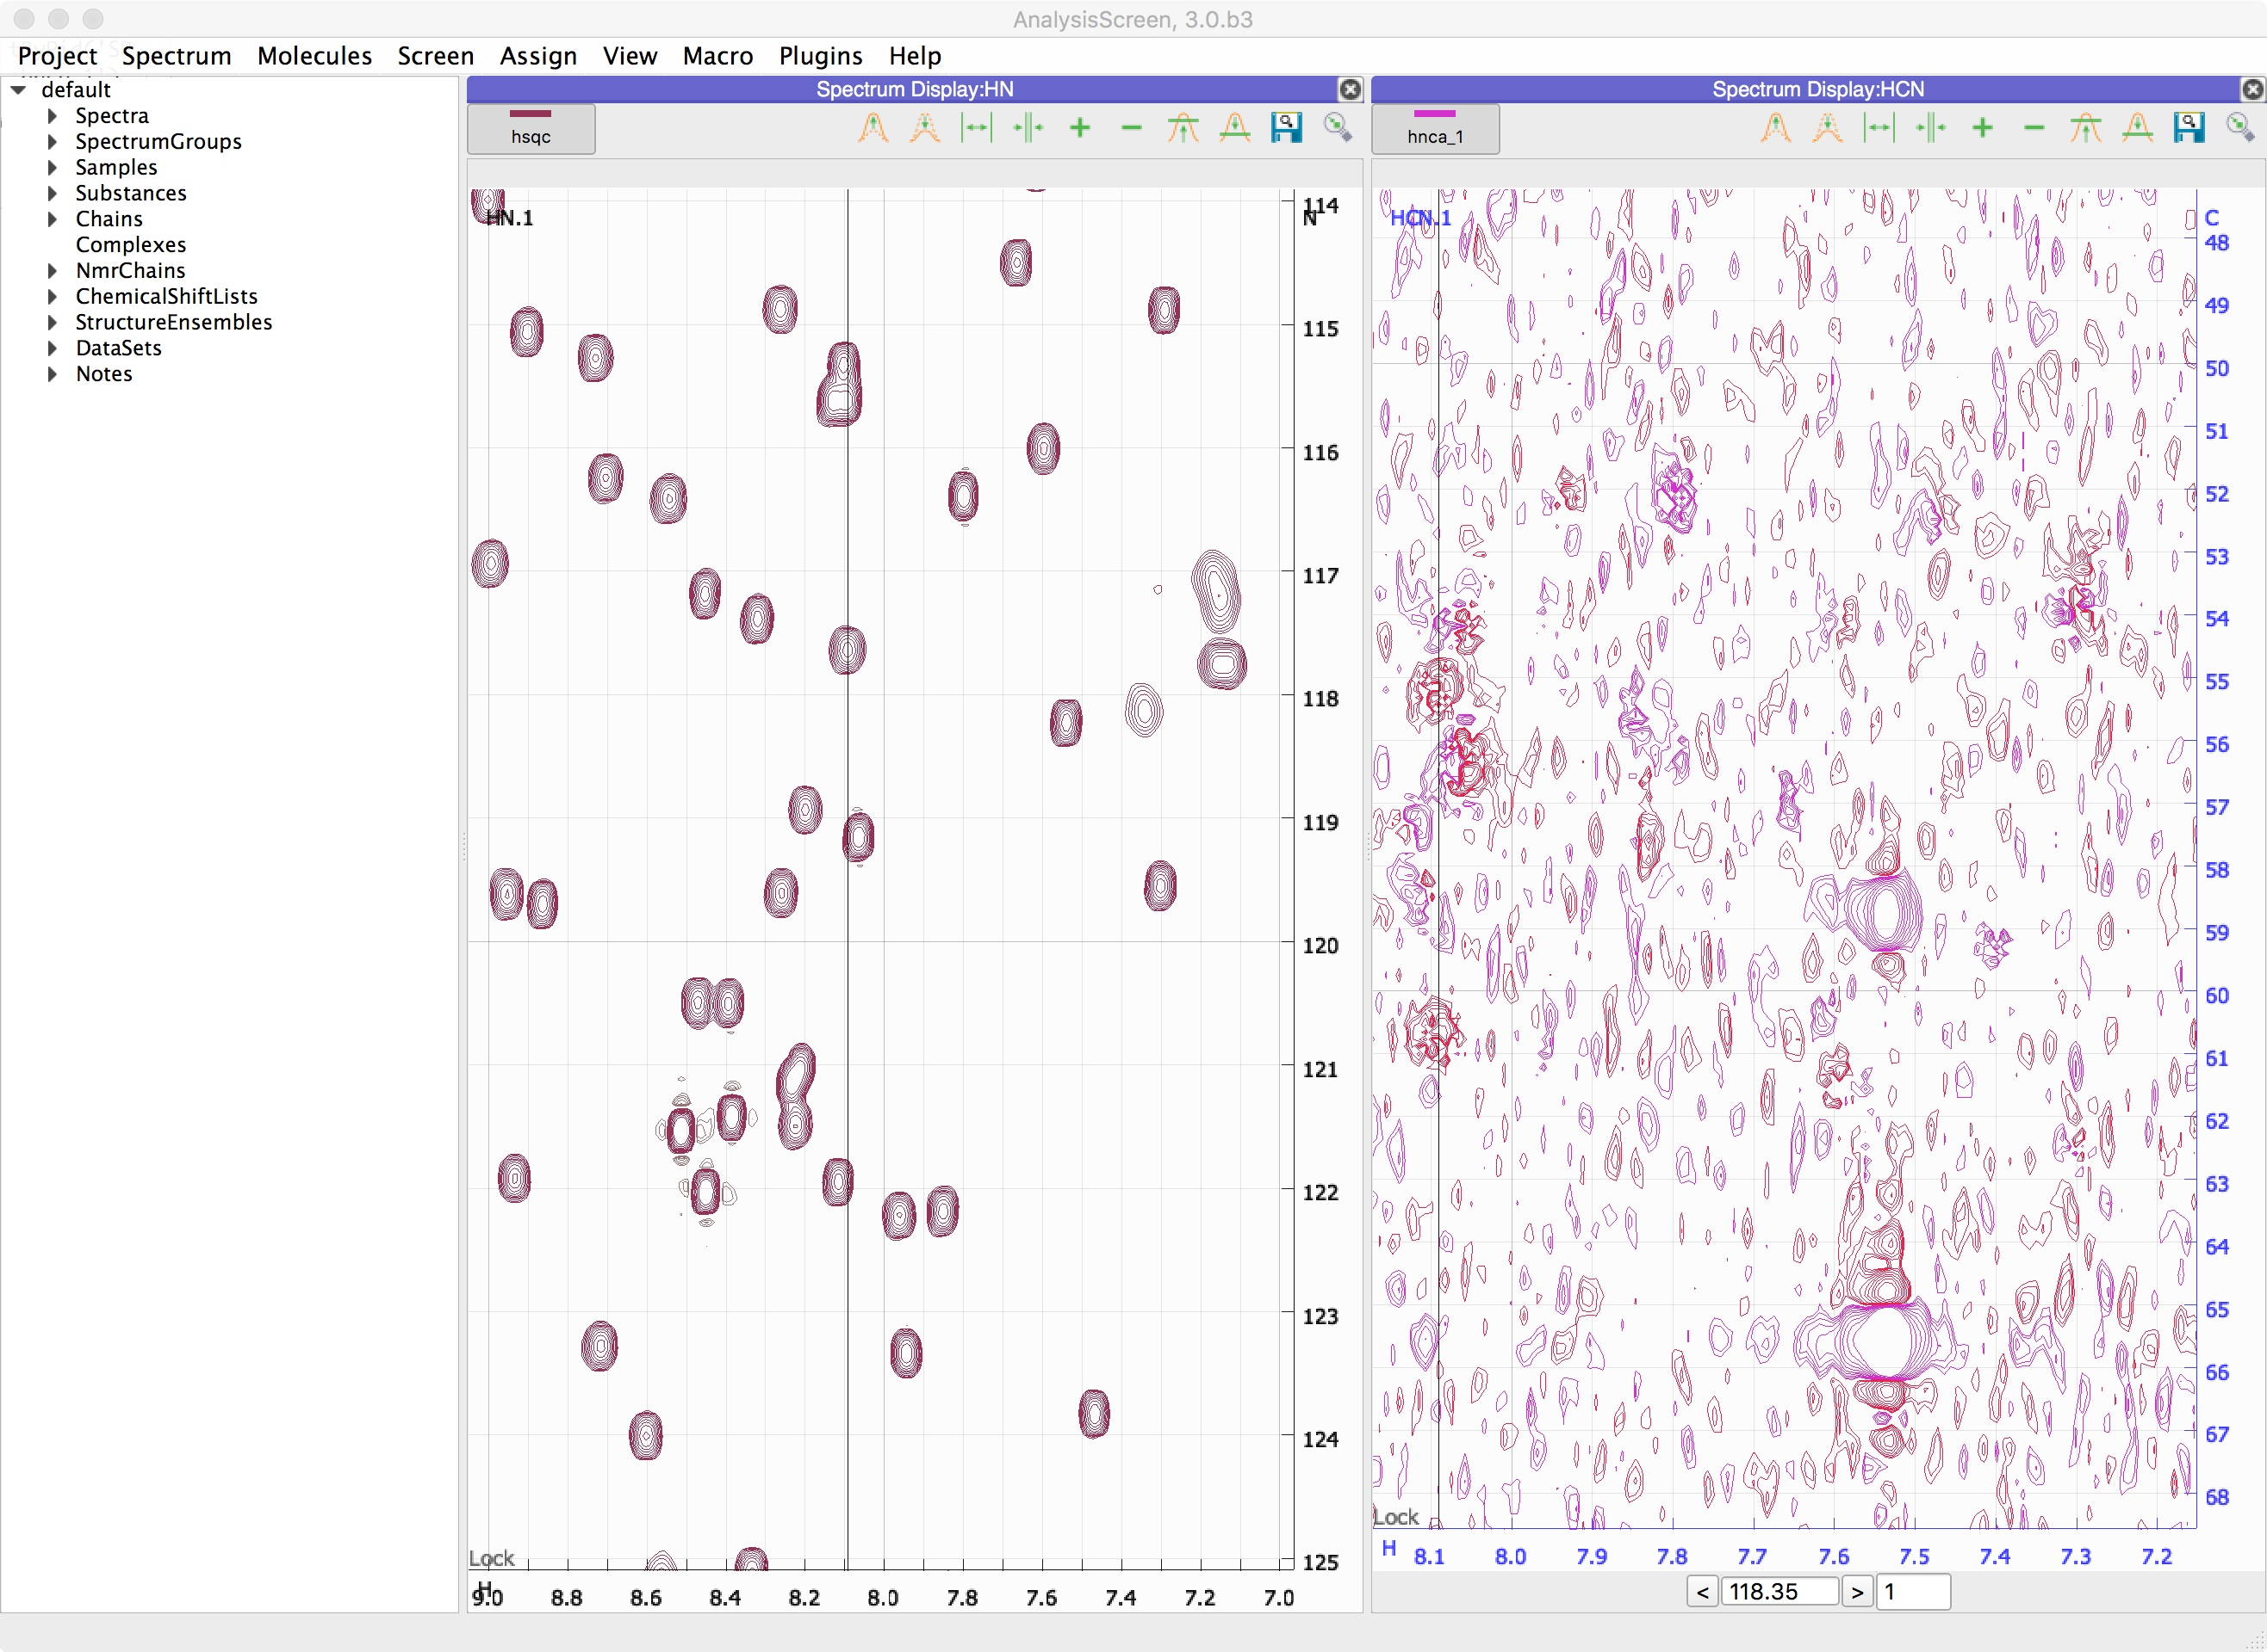
2
Displaying spectra
Change planes
2A
Change planes on the hnca
At the bottom of the display is a Z toolbar with a strip label; two arrows for changing planes, a box showing the ppm position of the z axis and a second box which shows how many planes are shown simultaneously.
The two arrows left and right of the z position box moves the spectrum one plane at a time.
The number of planes can be changed by editing the plane count manually or by using the mouse wheel while hovering over the box. The z position can also be changed using the mouse wheel in the same way.

Slide 7


2
Displaying spectra
Increase Contours
Contour base Up
2B
Adjust contours
Go on the hnca spectrum display
locate the icons
Raise the contour level by click on
This will increase by a default factor of 1.41. To have access to more settings:
right click on the spectrum display
select contours

Slide 8
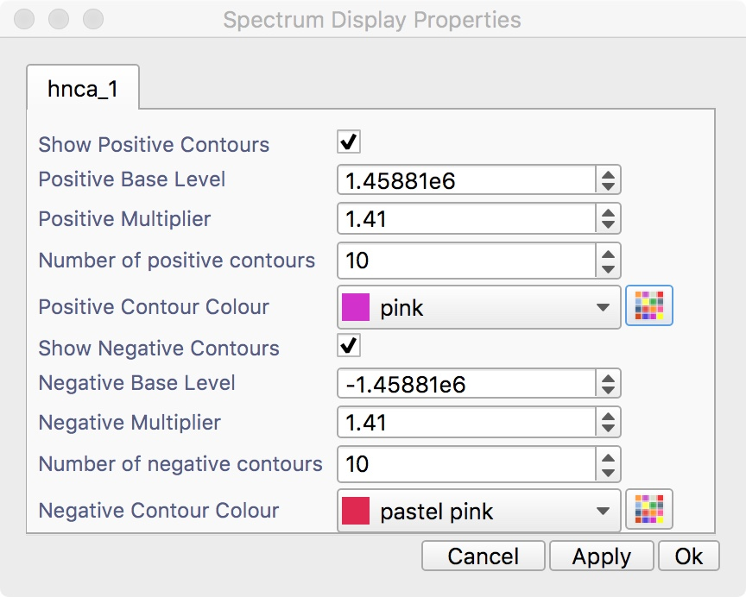
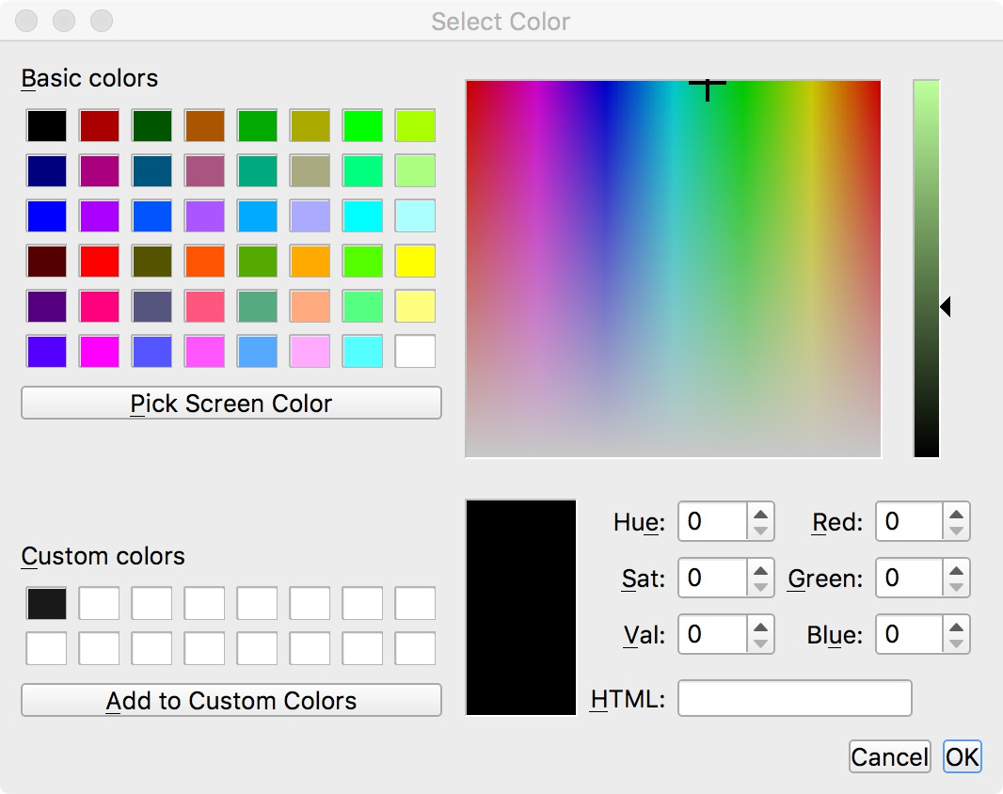
2
Displaying spectra
Customise Contours
2C
Customise contours
This popup contains values that can be changed to manipulate how the contours are displayed for that spectrum.
Contour base levels, multipliers and number of contours can be changed by adjusting the value with the mouse wheel or directly writing into the box.
Checking and unchecking the check boxes will show or hide the positive/negative contours. To change the colour of the contours, you can either select from the list of standard colours using the drop down list or select one of your own by clicking the Multi-coloured button, which will popup a Colour dialog. Once you have selected your colour and pressed OK the colour will appear in the drop down list as Colour + a number and will be stored for future use.

Slide 9
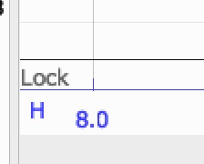
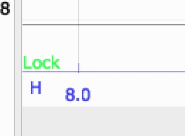
2
Displaying spectra
Mouse actions:
Pan the spectrum
Zoom box
Zoom In – Out (all axes)
Zoom In – Out (one axis)
2D
Mouse actions
Dragging the left mouse button around a spectrum display will pan the spectrum in the direction of movement and the mouse wheel will zoom the x and y axes simultaneously. If you want to zoom into a specific area, using SHIFT+Right Drag it will cause a yellow box to be drawn on the display, which specifies the zoom region.
You can also “lock” the spectrum aspect ratio by toggling the lock button at the bottom-left part of the display. This will disable the single axis zoom.

Slide 10
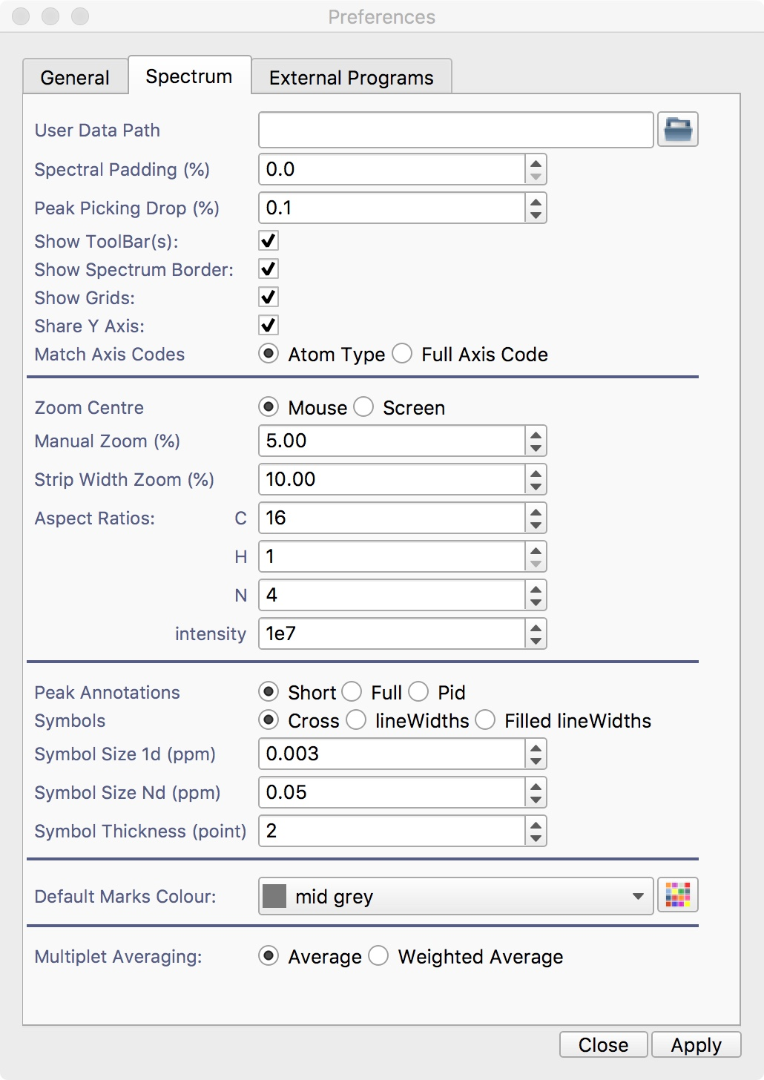
2
Displaying spectra
Spectrum display preferences
2E
Zoom preferences
Go on Main Menu ⟶ Preferences…
Select the Spectrum tab
Modify the zoom behaviour from the middle section
2F
Keyboard actions
Select a spectrum display by clicking any point, this will set the strip as “current” and will highlight the axis.
Use the keys “+” and ”-” to zoom in and out
Use the directional keys to move across the spectrum

Slide 11
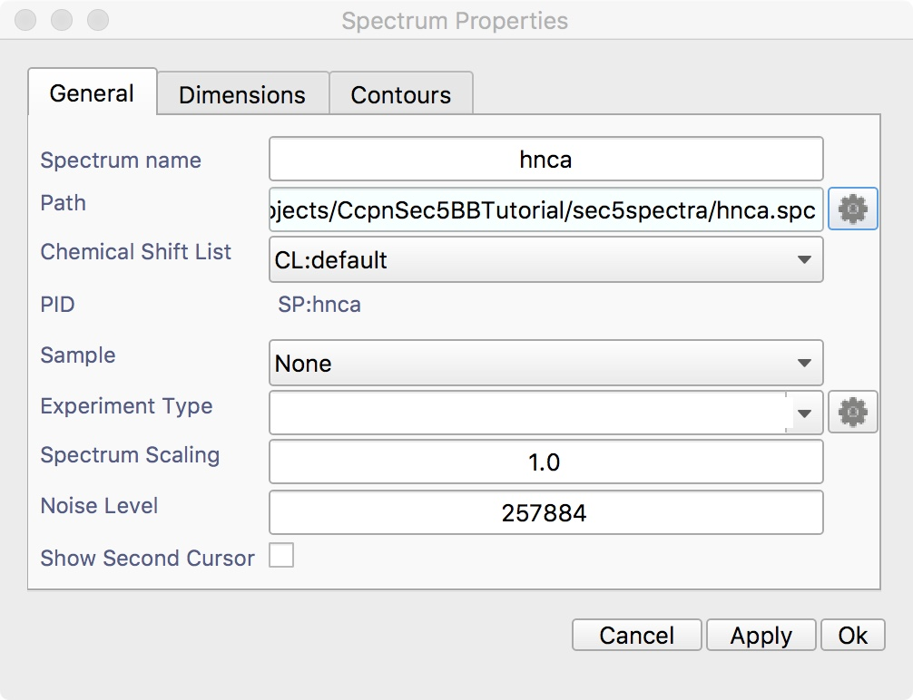
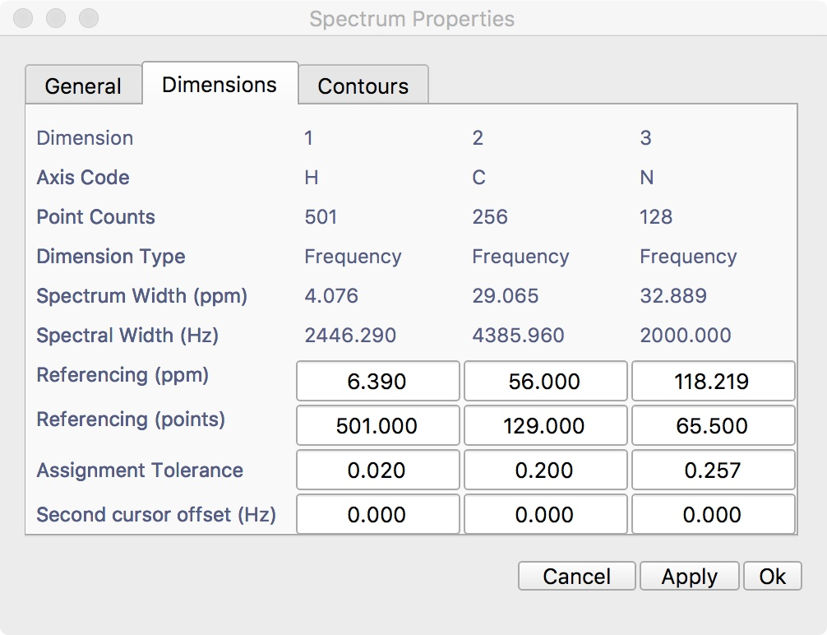
3
Setting spectra
To Change spectrum parameters:
Double click
3A
Change parameters
To change properties of a spectrum including the contour colours, double click its name in the Sidebar and a dialogue box will popup with a series of tabs in it.
In the first tab, you can set general parameters of the spectrum, such as type, path, name, scaling, spectrum type etc. Changing the values in each box and hitting Apply will change the parameter value.
In the Dimensions tab, you can view information on each dimension of the spectrum and change referencing and assignment tolerances for each dimension.

Slide 12
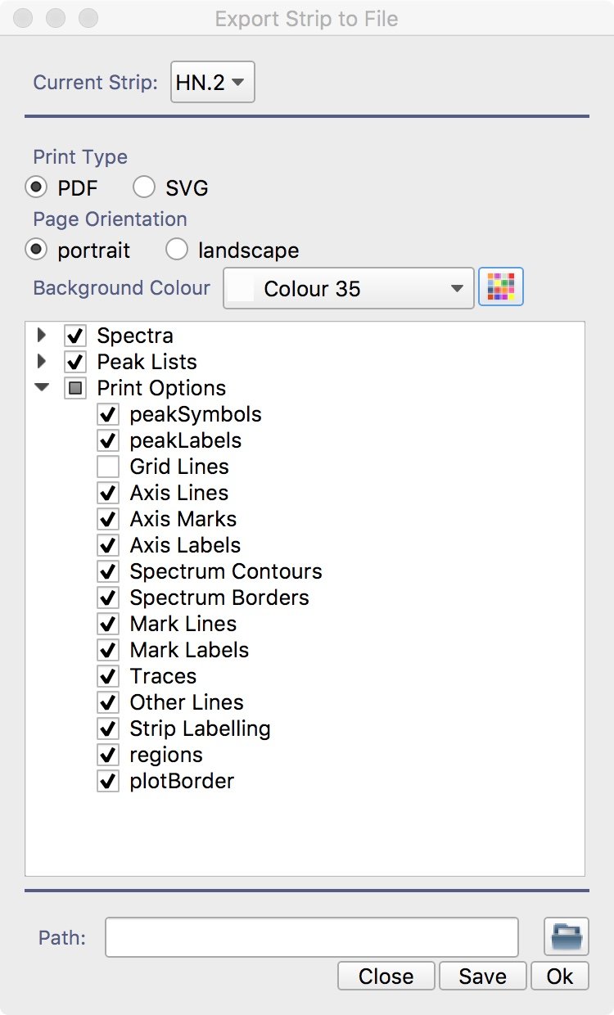
4
Printing spectra
Add-remove strips
Add-remove strips with the “+”,”-” button on the spectrum toolbar
4A
Print to file
Right click on display to print
Click on Print to file… The popup will appear
Select the strip. You can select one at the time or all strips in the spectrum display. Select the option of interest.
Select a path where to save using the folder icon
press ok

Slide 13
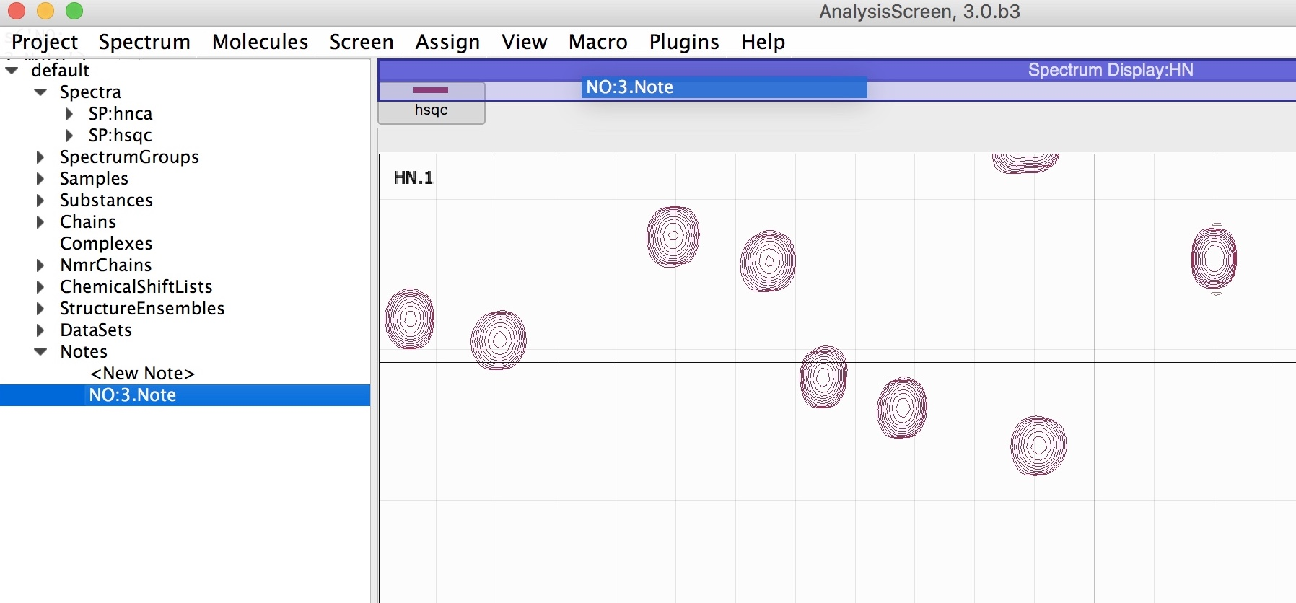
5
Notes
Double Click
Drag and drop over the purple bar
5A
Create a note
Analysis V3, also provides a means to make free text notes and store them with the project. To create a note:
Go on sidebar
click on the note arrow to expand the branch
double click on on <New Note>. This will create a new note
To open it:
Select the new item and drag hovering the top of any existing module and drop it as soon as you see a transparent purple box; alternatively, right click on the sidebar item and select “open as a module”
You can write any text and all changes will be automatically saved on the project.

Slide 14
6
Rearranging Modules
Origin Module
Left Click, hold and Drag
Origin Module
The module is highlighted
Origin Module
Target Module
Drag over the target module name
Origin Module
Target Module
Target Module
Move on location,
Drop on semi-transparent bar
Target Module
Target Module
Target Module
6A
Rearrange a layout
To move a module:
hold the left mouse button down on the purple bar of the module (the module label). The module will be highlighted.
drag it first over the top of any another module, this will activate the dropping area to accept the drop. A semi-transparent rectangle will appear
keep holding the left mouse and move either the top, bottom, left or right of another module, for each move the a new rectangle will appear, you can release the mouse to move the module in that position.

Slide 15
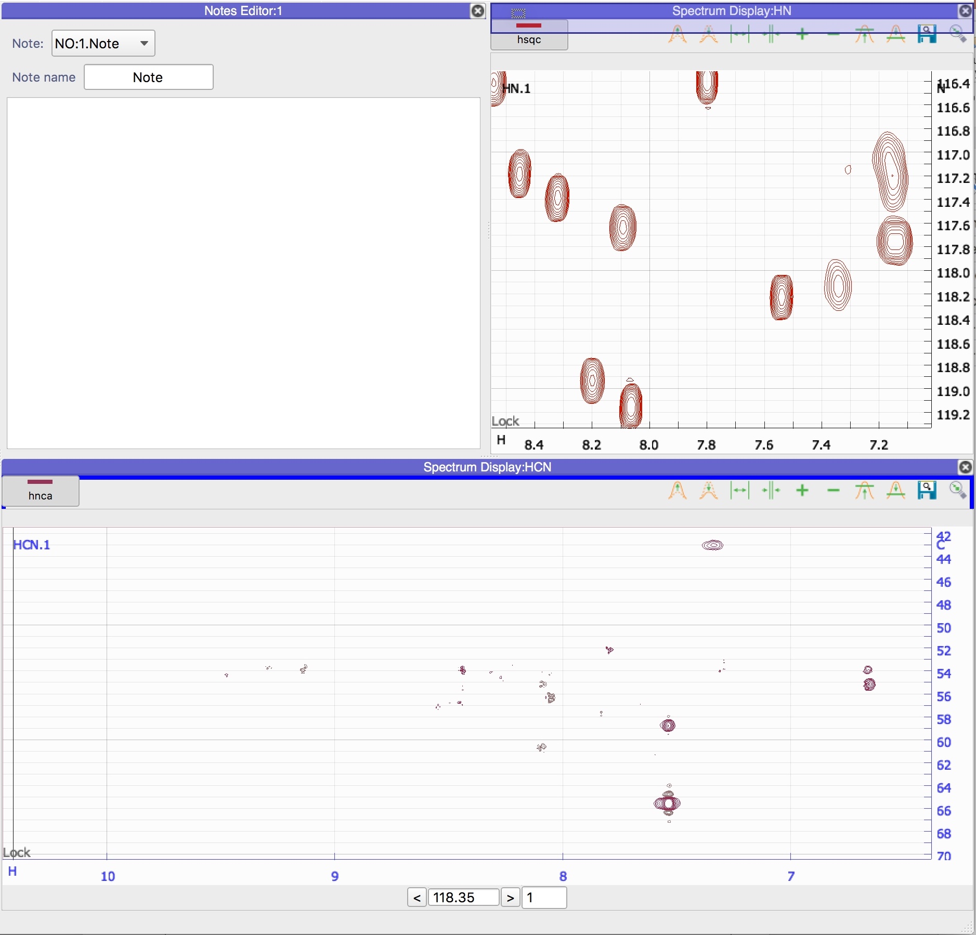
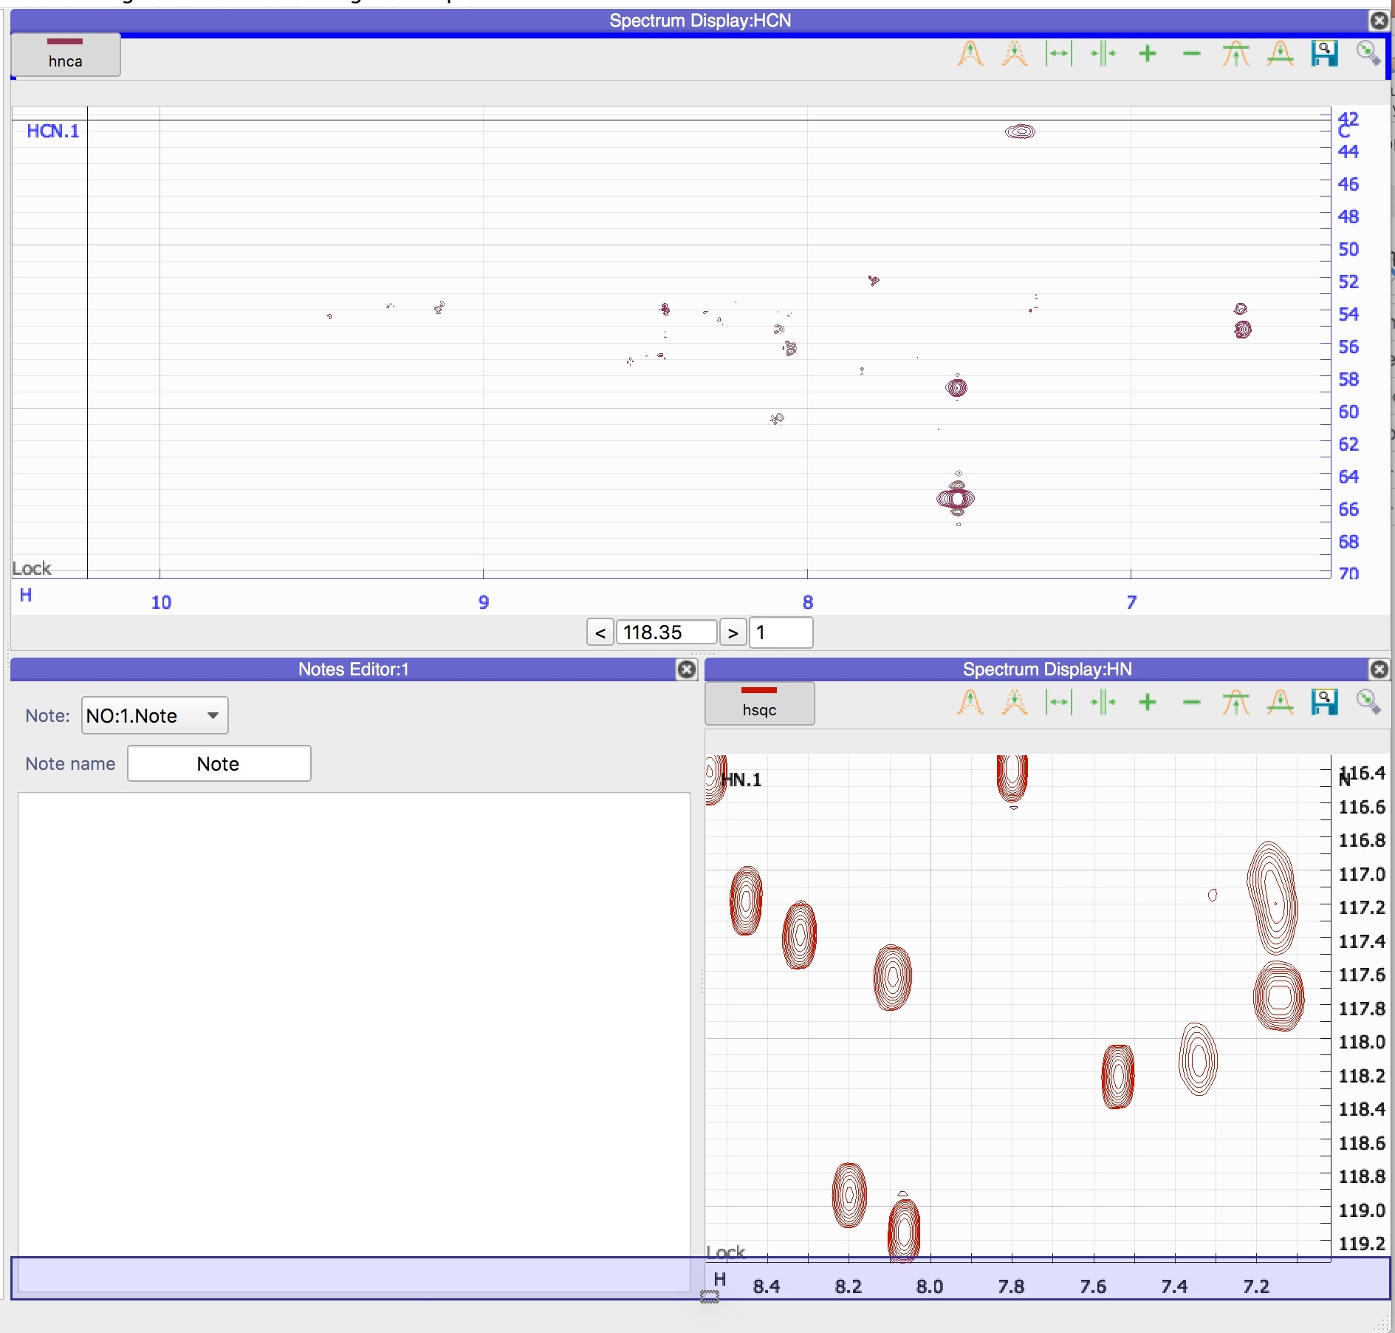
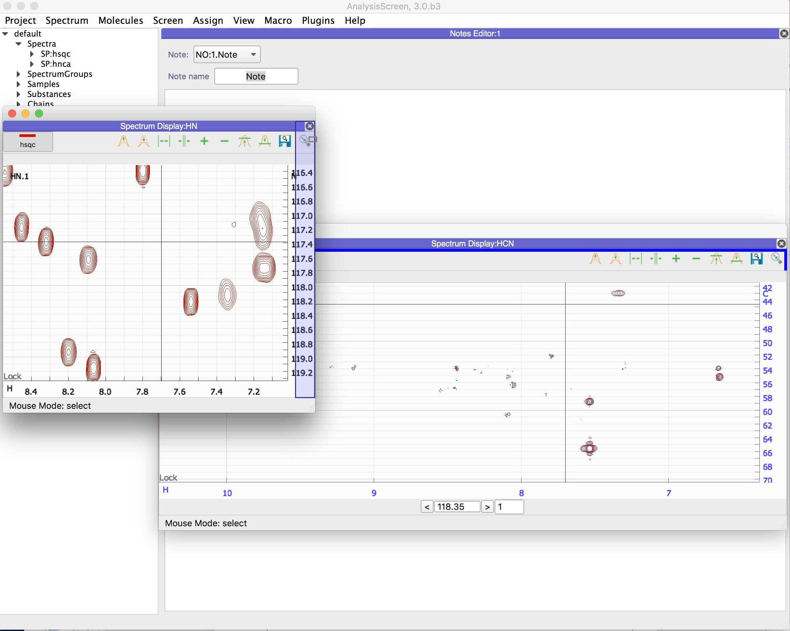
6
Rearranging Modules
On top
Under Two
Pop-in back on the Main area
Move in a temporary Area
In general, anything that isn’t a popup is a module and these can be easily rearranged in any way you want. Use the right click to see the available actions. You can also pop-out a module; simply double click on the title bar. This will create a new window, containing the module and is called a temporary drop area. The temporary drop area has the drag and drop feature of the main drop area.

Slide 16
CcpNmr Analysis Version 3
Contact Us
Website:
www.ccpn.ac.uk
Suggestions and comments:
ccpnmr3@google.com
Issues and bug report:
https://bitbucket.org/ccpnmr/issue-tracker/
Cite Us
Skinner, S. P. et al. CcpNmr AnalysisAssign: a flexible platform for integrated NMR analysis. J. Biomol. NMR (2016). doi:10.1007/s10858-016-0060-y
Tutorial Version History:
beta1 (SS): First version beta2 (GWV): Minor changes
beta3 (LGM): Re-designed and added several steps

